Slide 1
Lecture 3 PHP CONTACT US FORM WITH DATABASE
BY ADNAN MAJEED
LECTURER COMPUTER SCIENCE

Slide 2
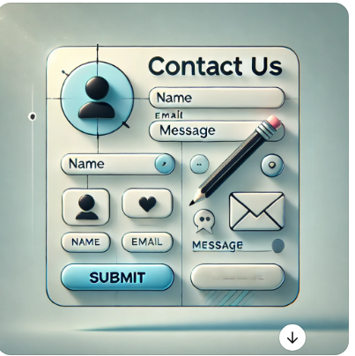
CONTACT US

Slide 3
PRE-REQUESITES
HTML Form to collect user information.
PHP Script to handle form submission and
store data into the database.
Database Table to store the contact form data.

Slide 4
CREATE DATABASE & TABLE IN XAMPP SERVER
CREATE DATABASE contact_form;
USE contact_form;
CREATE TABLE messages (
id INT(11) AUTO_INCREMENT PRIMARY KEY,
name VARCHAR(100) NOT NULL,
email VARCHAR(100) NOT NULL,
message TEXT NOT NULL,
submitted_at TIMESTAMP DEFAULT CURRENT_TIMESTAMP
);

Slide 5
CONTACTFORM.PHP
<!DOCTYPE html>
<html lang="en">
<head>
<meta charset="UTF-8">
<meta name="viewport" content="width=device-width, initial-scale=1.0">
<title>Contact Us</title>
</head>
<body>
<h1>Contact Us</h1>
<form action="contact.php" method="post">
<label for="name">Name:</label>
<input type="text" id="name" name="name" required><br><br>

Slide 6
CONT …….
<label for="email">Email:</label>
<input type="email" id="email" name="email" required><br><br>
<label for="message">Message:</label><br>
<textarea id="message" name="message" rows="4" cols="50" required></textarea><br><br>
<button type="submit" name="submit">Send Message</button>
</form>
</body>
</html>

Slide 7
CONTACT.PHP
<?php
// Database connection
$servername = "localhost"; // Your server name (usually localhost)
$username = "root"; // Your database username
$password = ""; // Your database password
$dbname = "contact_form"; // The name of your database
// Create connection
$conn = new mysqli($servername, $username, $password, $dbname);
// Check the connection
if ($conn->connect_error) {
die("Connection failed: " . $conn->connect_error);
}

Slide 8
CONT …..
if (isset($_POST['submit'])) {
// Sanitize form data to prevent SQL injection
$name = mysqli_real_escape_string($conn, $_POST['name']);
$email = mysqli_real_escape_string($conn, $_POST['email']);
$message = mysqli_real_escape_string($conn, $_POST['message']);

Slide 9
CONT……
// Insert data into the database
$sql = "INSERT INTO messages (name, email, message) VALUES ('$name', '$email', '$message')";
if ($conn->query($sql) === TRUE) {
echo "Your message has been sent successfully!";
} else {
echo "Error: " . $sql . "<br>" . $conn->error;
}
}
$conn->close();
?>

Slide 10
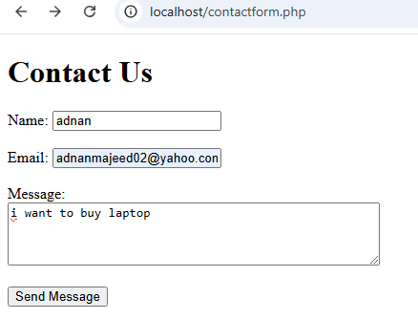
FRONT END DISPLAY IN BROWSER

Slide 11
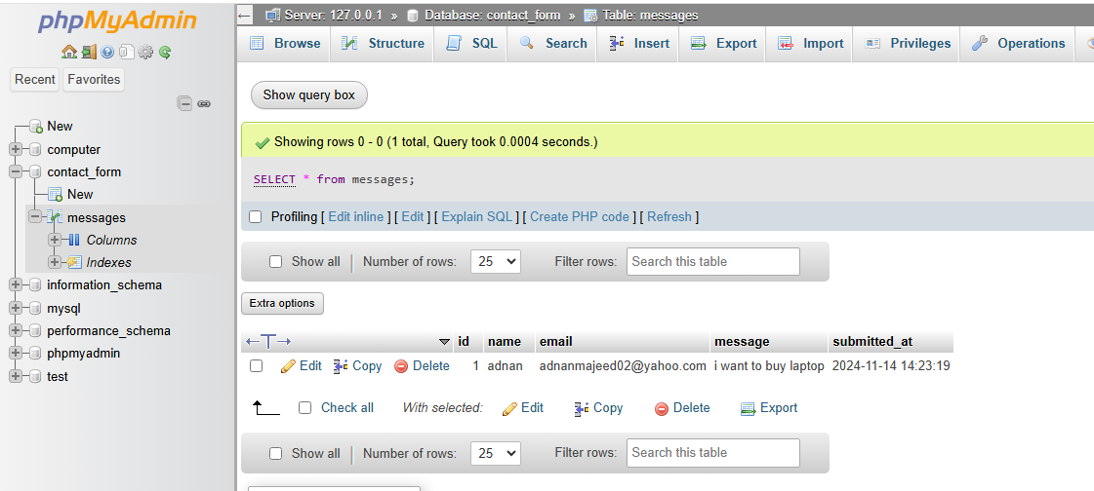
OUTPUT

Slide 12
THANKS

